Slide 1


MINOR PROJECT
Google Stock Price Prediction Using Deep Learning
Presented By:
R2142201580- Ayush Goel
R2142201811- Kalpana Srivastava
R2142201666- Md Saif Anjum Khan
R2142201690- Yachika Maheshwari
Mentor- Dr. Ambika Aggarwal

Slide 2
Content
Introduction
Result
Comparative Study
Conclusion

Slide 3
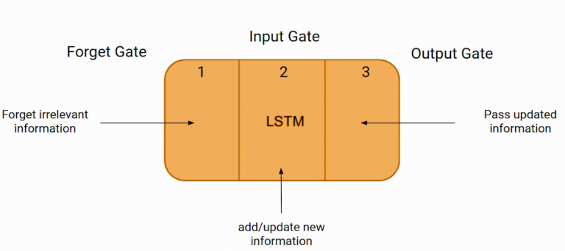
Introduction
Technical Background
LSTM Architecture
These three parts of an LSTM cell are known as gates. The first part is called Forget gate, the second part is known as the Input gate and the last one is the Output gate.

Slide 4

Introduction
Technical Background
LSTM Architecture

Slide 5
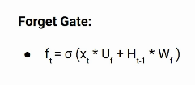
LSTM Architecture
Forget Gate: In a cell of the LSTM network, the first step is to decide whether we should keep the information from the previous timestamp or forget it. Here is the equation for forget gate.
Xt: input to the current timestamp.
Uf: weight associated with the input
Ht-1: The hidden state of the previous timestamp
Wf: It is the weight matrix associated with hidden state

Slide 6
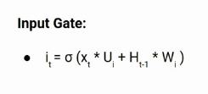
LSTM Architecture
Input Gate: “Amit knows swimming. He told me over the phone that he had served the navy for four long years.”
Input gate is used to quantify the importance of the new information carried by the input. Here is the equation of the input gate:
Here
Xt: Input at the current timestamp t
Ui: weight matrix of input
Ht-1: A hidden state at the previous timestamp
Wi: Weight matrix of input associated with hidden state
Again we have applied sigmoid function over it. As a result, the value of I at timestamp t will be between 0 and 1.

Slide 7


LSTM Architecture
Output Gate: “Mr. Singh single-handedly fought the enemy and died for his country. For his contributions, brave________ .”
Output gate, which is pretty similar to the two previous gates.
Its value will also lie between 0 and 1 because of this sigmoid function. Now to calculate the current hidden state we will use Ot and tanh of the updated cell state. As shown below.

Slide 8
Results
Tests Cases
LSTM
Long Short-Term Memory (LSTM) models are well-suited for predicting time-series data like stock prices because they can capture complex patterns and dependencies in the data. LSTM models are designed to handle sequential data and can learn long-term dependencies between data points. This is important for stock price prediction, as stock prices are influenced by a wide range of factors that may have a delayed or cumulative effect on the price. Additionally, LSTMs can handle non-linear relationships and can learn from past errors, making them effective for predicting stock prices, which are notoriously difficult to forecast accurately. Overall, LSTM models are a powerful tool for analyzing time-series data and are well-suited for predicting Google stock prices.

Slide 9
Results
Tests Cases
ARIMA
Autoregressive Integrated Moving Average (ARIMA) models are another popular method for predicting stock prices, including the Google stock price. ARIMA models are based on the assumption that the time-series data is stationary, which means that the statistical properties of the data do not change over time. This assumption is often reasonable for stock prices, which tend to exhibit stationary behavior over short periods of time. ARIMA models can capture the trend, seasonality, and cyclical behavior of the data, which is important for predicting stock prices that are influenced by a wide range of factors. Additionally, ARIMA models can handle both univariate and multivariate time-series data, making them a versatile tool for stock price prediction. Overall, ARIMA models are an effective method for analyzing time-series data and are a useful tool for predicting Google stock prices.

Slide 10
Results
Tests Cases
SVM
Support Vector Machines (SVM) are a type of machine learning algorithm that can be used for stock price prediction, including the Google stock price. SVM models are particularly useful when the data is non-linear, which is often the case with stock prices. SVM models work by identifying the optimal hyperplane that separates the data points into different classes, with the goal of maximizing the margin between the classes. In the context of stock price prediction, SVM models can be used to classify the data into different categories, such as "up" or "down" based on past patterns in the data. SVM models can also handle both univariate and multivariate time-series data and can be used for both regression and classification problems. Overall, SVM models are a powerful tool for analyzing time-series data and can be an effective method for predicting Google stock prices.

Slide 11
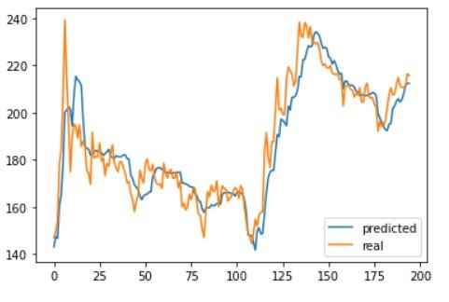
Comparative Study
LSTM

Slide 12
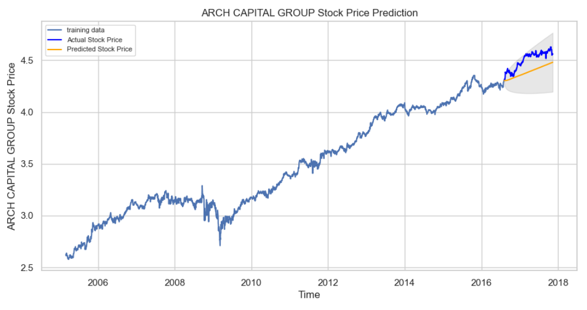
Comparative Study
ARIMA

Slide 13
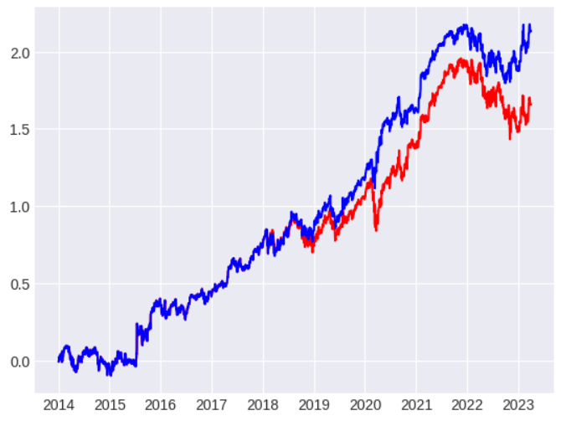
Comparative Study
SVM

Slide 14
Conclusion
Future Scope
LSTM models are highly complex and require a large amount of computational power to train and evaluate. As the amount of data increases, so does the complexity of the model, which can lead to overfitting. Overfitting occurs when the model becomes too complex and starts to memorize the training data instead of learning general patterns that can be applied to new data. This can lead to poor generalization and inaccurate predictions on new data. To address this challenge, techniques such as l1 and l2 regularization(which add a penalty term to the loss function to discourage large weights in the model) early stopping, and dropout can be used to prevent overfitting and improve the generalization ability of the model.

Slide 15
Conclusion
Future Scope
Another potential application of LSTM in Google stock price prediction is to use it to optimize investment strategies. LSTM models could be used to predict the future performance of Google stocks, and then these predictions could be used to optimize investment strategies to maximize returns and minimize risk.
One limitation of LSTM models is their lack of interpretability, making it difficult to understand how the model is making its predictions. In the future, researchers could develop methods to improve the interpretability of these models, allowing traders and investors to better understand the reasoning behind the model's predictions.

Slide 16
Thank You

